Slide 1
NoteShare System Architecture
Nathan Denklau
Nathan Fritze
Joe Trapani
Jonathan Hall
Satpreet Singh

Slide 2
Presentation Overview
High-Level System Architecture
Component Overview
Component Level View/Interfaces
Sequence Diagrams
ER Diagram
Mock-ups

Slide 3
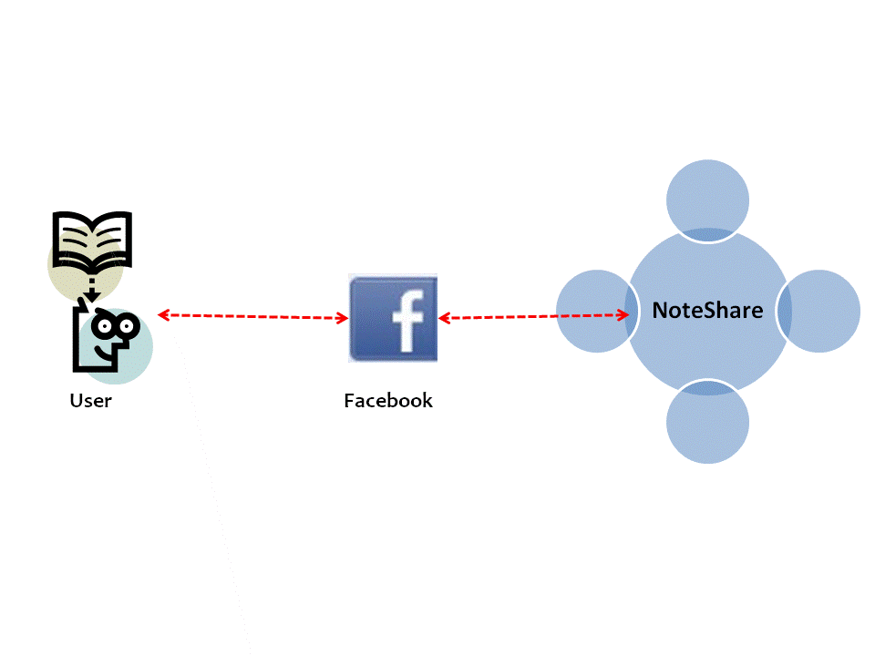
High-Level System Architecture

Slide 4
Component Overview

Slide 5
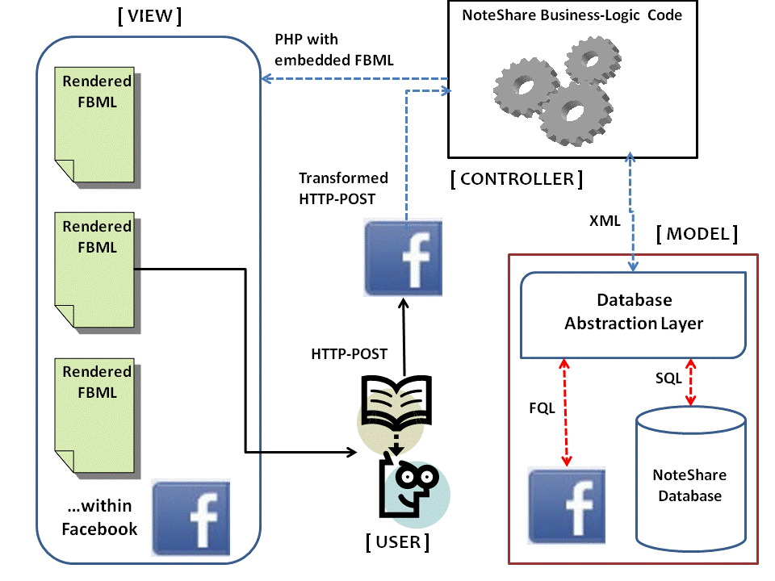
Component View

Slide 6
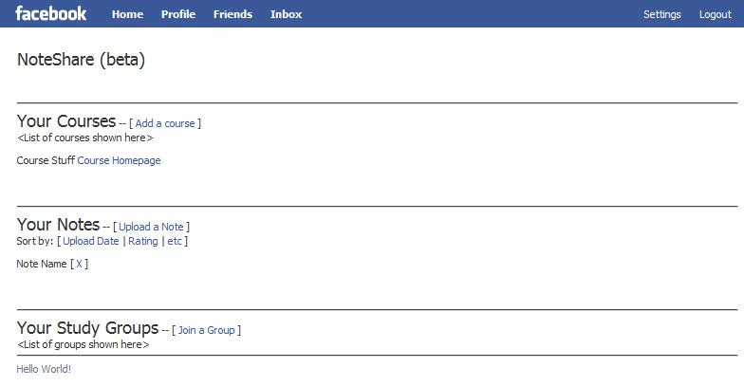
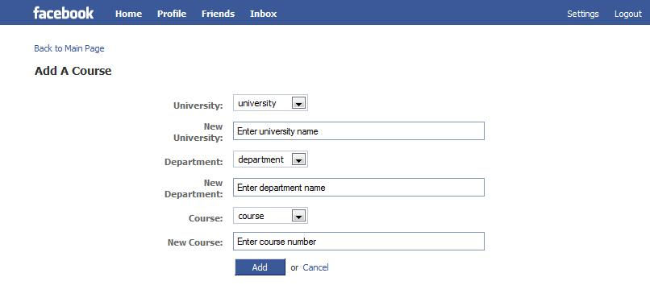
Mock-ups

Slide 7
Sequence Diagram
There will be more than one…add more slides

Slide 8
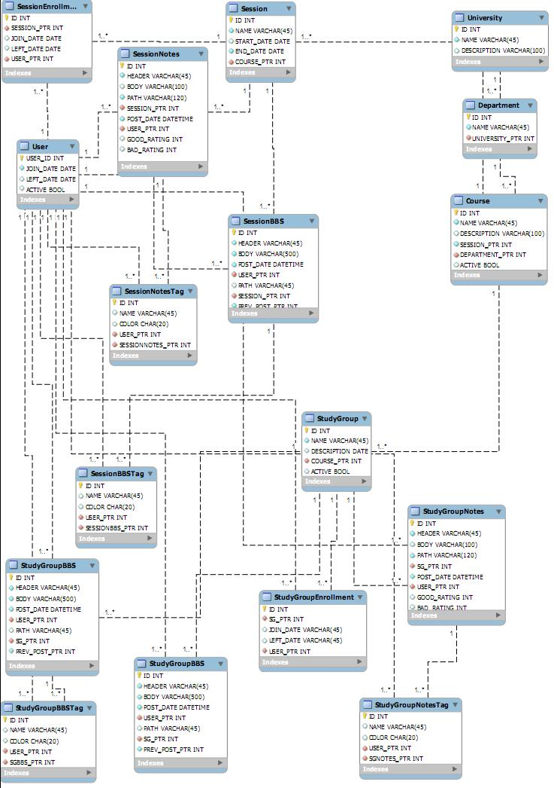
ER Diagram

Slide 9
Interfaces

Slide 10
Questions?

